Slide 1
User Model and WorkFlow Model
Mohammed Rifaz

Slide 2

01
PART 0NE
Adding Users
CONTENTS
02
PART 0NE
Users And Permissions
03
PART 0NE
Role and Role Profile
04
PART 0NE
WorkFlow Model

Slide 3
01
Adding Users
There are two main types of users:
Website users: Customers, Suppliers, Students, etc., who have access only to the portal and not to any modules.
System Users: People using ERPNext in the Company with access to modules, company data, etc.
Users can be added by the System Manager. To add users go to: > Home > Users and Permissions > User
Under User, a lot of info can be entered. For the sake of usability, the information entered for web users is minimal: First Name and Email.
An Email address is the unique key (ID) identifying the Users.

Slide 4
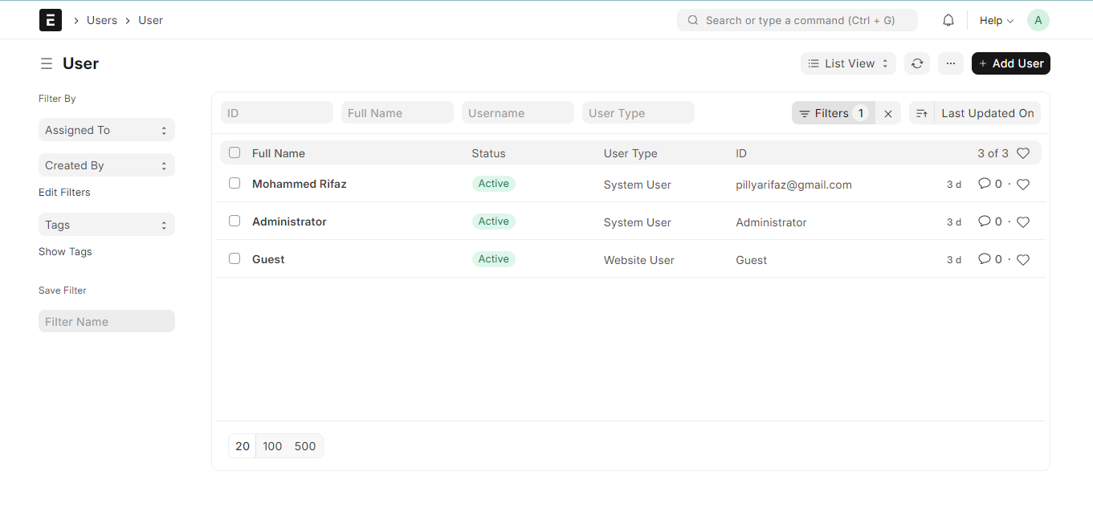
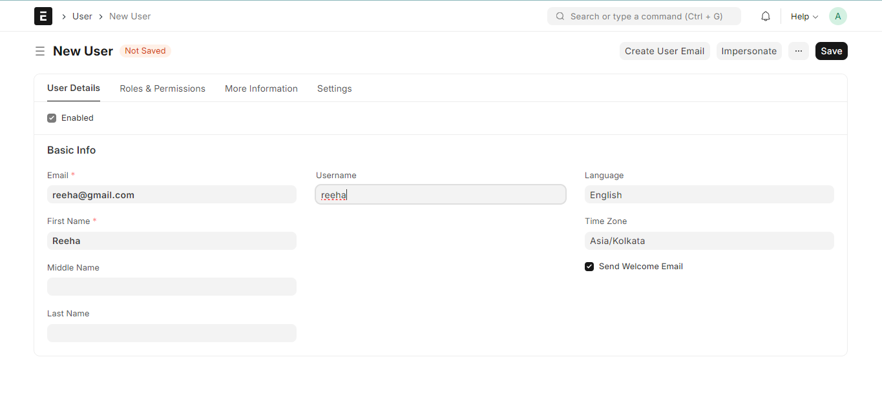
1. How to Create a New User
1) Go to the User list, click on New.
2) Add an Email address and name of the user.
3) Save.

Slide 5
1.1 More Information
More information about the employee can be set from this section:
Gender
Phone
Mobile No
Birth Date
Location
Interests
Bio
Ticking on 'Mute Sounds' will mute sounds that play on interacting with documents. The user may need to do a Settings > Reload for the changes to take place.

Slide 6
1.2 Users And Permissions
In ERPNext, you can create multiple users and assign them different roles.
A role is a set of permissions assigned to a user so that they can access the documents they need to. For example, a sales employee will need access to sales transactions but will not have access to approve leaves.
Some users can only access the public-facing part of ERPNext (i.e. a portal view). Such users are called "Website Users". "System Users" will have access to modules and can access documents as per the roles set.
ERPNext implements permission control at the User and Role level. Each user in the system can be assigned multiple roles and permissions. The most important role is "System Manager". Any user having this role can add other users and set roles for all users.

Slide 7
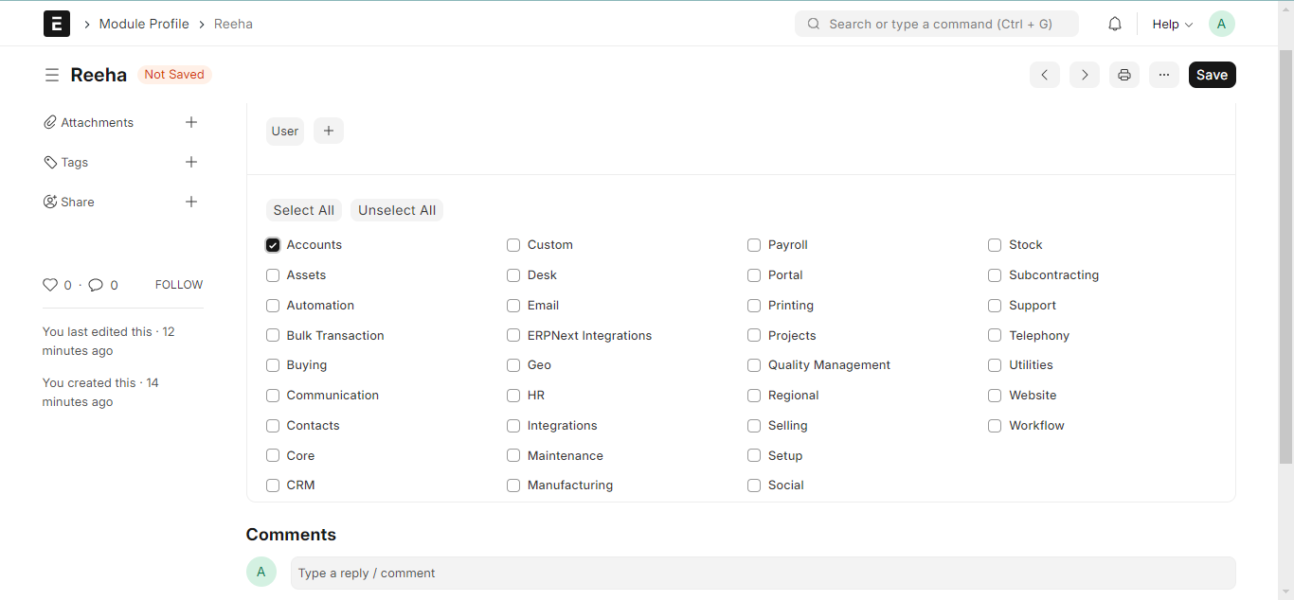
1.3 Setting Roles
After saving, you will see a list of roles and checkboxes next to them. Just check the roles you want the user to have and save the document.

Slide 8
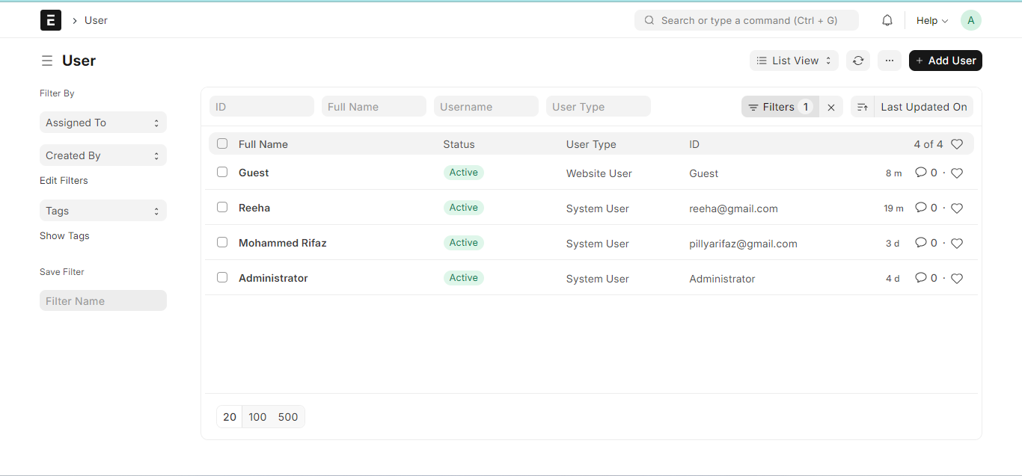
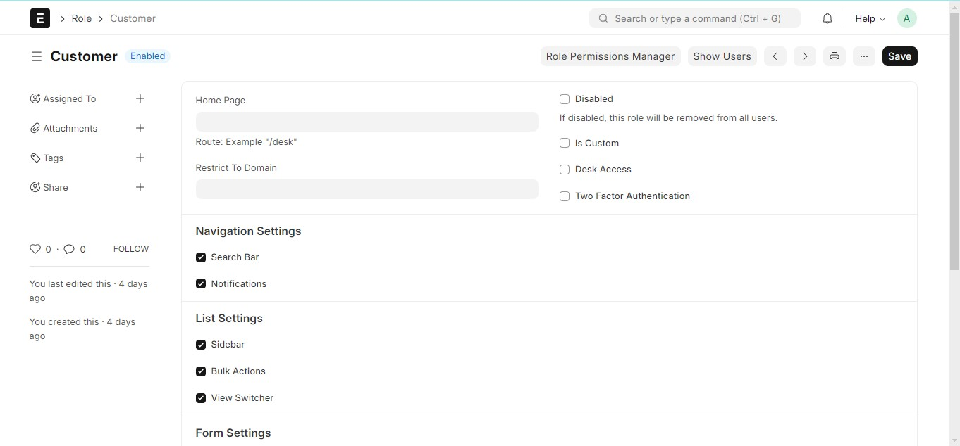
1.4 Website Users

Slide 9
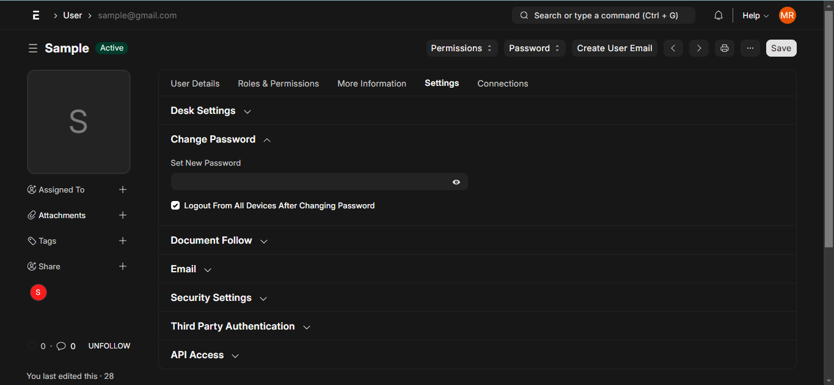
1.5 Change Password Set New Password: As a System Manager, you can set a new password for the user if it needs to be changed. Send Password Update Notification: Send an email notification to the user that their password has been changed. Log out from all devices while changing Password: When changing the user's password, this logs out the user from PC and any mobile device they may have logged into.

Slide 10
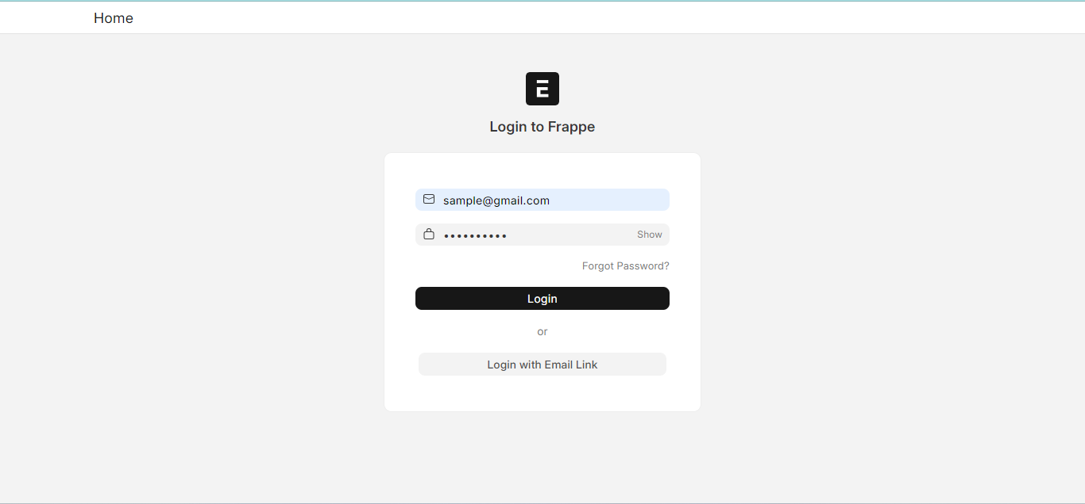
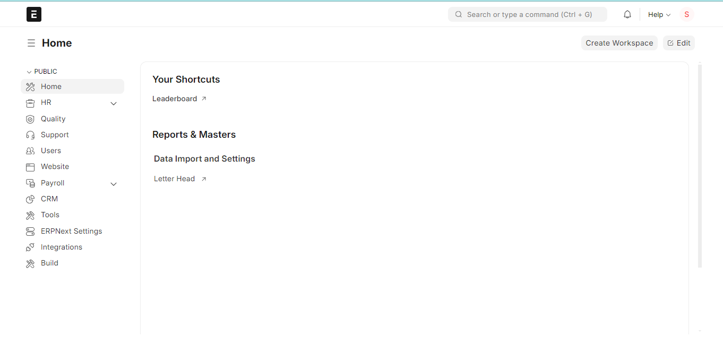
1.6 Login as User Sample
Here I have created a user called “Sample”.
Give a role of HR.
When Sample login inside ErpNext Using UserId and Password you can see only the HR Model is available for her.

Slide 11
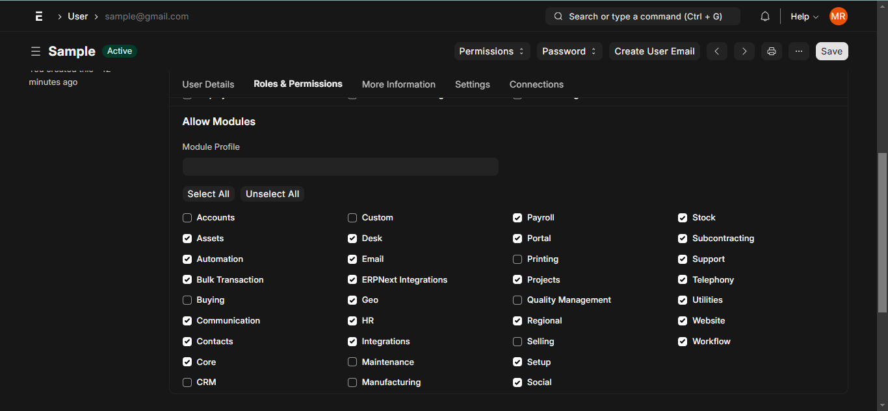
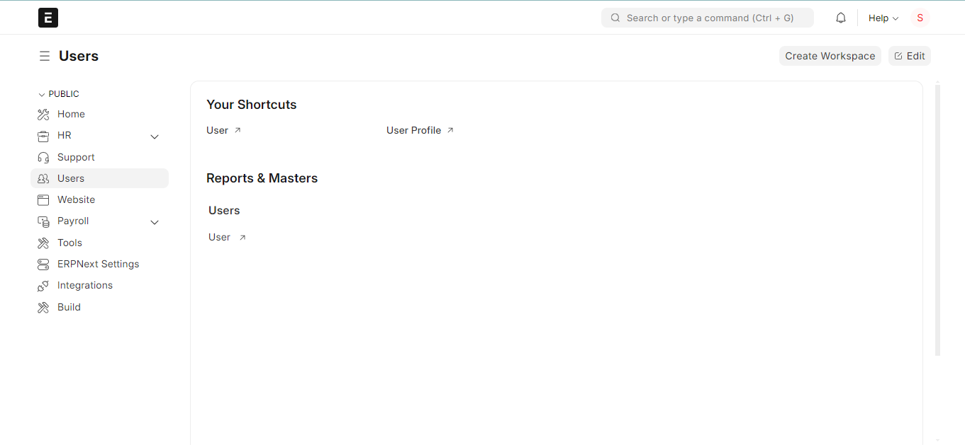
1.7 Allow Module Access
Users will have access to all modules for which they have role-based access. If you want to restrict access of certain modules for this user, un-check the modules from this list.

Slide 12
1.8 Third Party Authentication This will allow users to use Facebook, Google, or GitHub to log in. To use this feature, signup for a developer account with Facebook, Google, GitHub, etc. Create an app on their console, specify an app name, the originating URL and callback URL, copy the client ID and client secret info here to start using.
1.9 API Access
You can generate API Secret keys from this section using the Generate Keys button. This can be used to access your account's data from another application, for example, an offline POS system.
1.10 Security Settings
Login After, Login Before: If you wish to give the user access to the system only between office hours, or during weekends, specify it here. For example, if office hours are from 10 am to 6 pm, set the Login After, Login Before hours as 10:00 and 18:00.
Restrict IP: Restrict user login to the IPs specified here. This can be used so that the user can log in only from office computers. Multiple IPs can be added separated by commas.
User Type: If the user has any role checked other than Customer, Supplier, Patient, or Student they automatically become a System User. This field is read-only.

Slide 13
2 Role and Role Profile
A Role defines the permissions for accessing various documents in ERPNext.
Roles define a set of permissions which can be set from the Roles Permission Manager. Most commonly used roles are already defined in ERPNext, you can use the system with them. If needed, you can add more roles. For example, if you assign the Sales User role to a user, they'll be able to access documents like Quotations and Sales Orders since the permissions are already set for the role Sales User.
Role profiles store different roles so that multiple roles can be assigned at once.
Role Profiles act as a template to store and select multiple roles. This Role Profile can then be assigned to a User. For example, a Sales Supervisor will have the roles Employee, Sales Manager, Sales User, and Sales Master Manager. Role Profiles are useful to assign multiple roles at once when adding multiple employees.

Slide 14
3 Role Based Permissions
Permission to different documents can be controlled using Role Based Permissions.
ERPNext has a role-based permission system. It means that you can assign Roles to Users, and Permissions can be set on Roles. The Role Permissions Manager allows you to set which roles can access which documents and with what permissions (read, write, submit, etc.).
Once roles are assigned to a user, their access can be limited to specific documents. The permission structure allows you to define different permission rules for different fields using a concept called Permission Level of a field.
1. How to use the Role Permissions Manager
To start using the Role Permission Manager, go to: > Home > Users and Permissions > Role Permissions Manager

Slide 15
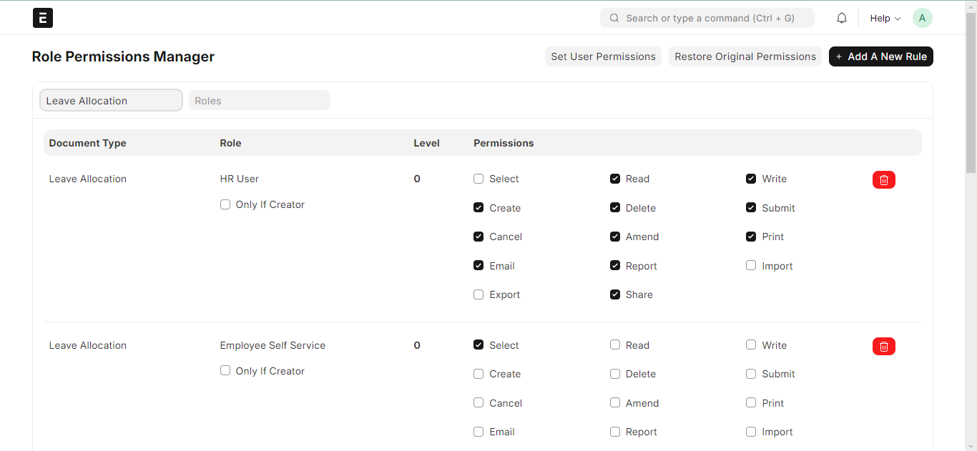
HR Manager should be able to see all Leave Applications. Create a Permission Rule for HR Manager at Level 0, with Read permissions. Apply User Permissions should be disabled.

Slide 16
4 Sharing
'Sharing' allows users to share a particular document with other users in ERPNext.
In addition to user and role permissions, you can also share a document with another user if you have sharing rights for that document. Note that, a shared document will be visible to the other user even if the document is restricted via User Permissions.
How to share a document?
Open the document that you want to share and click on the '+'icon under 'Shared With'.
Select the user with whom you need to share the document.
If the document is to be shared with all users then just select 'Everyone'.
Tick appropriate checkboxes to provide relevant rights to the user with whom the document is getting shared.
Click on the Add button to get the user added.
You can share the same document with multiple users by adding them one by one.

Slide 17
5 Limited User The user will get limited access to the system. Limited users can access only specific documents of the specific modules. Certain users don't use all the modules and need only specific modules. For example, in the company, to record the daily attendance or leave application every employee was given required system access. But assume 500 people are working in the company out of which only 100 use all documents and the remaining 400 need only documents for daily attendance or leave applications. Such users are limited users. The User Type document plays an important role to handle this use case. There are default User Types, "System User" and "Website User", the System User can access the desk and website portal whereas the Website User can only access the website portal. To handle the case of limited access of documents for the employees by default ERPNext has added a new user type 'Employee Self Service'.

Slide 18
6 Administrator The administrator is above the System Manager and has all the rights and permissions for an ERPNext account. A System Manager also has permissions to most items in the system, but the Administrator has unrestricted access.

Slide 19
02
Work Flow

Slide 20
WorkFlow
With workflows you can rewrite how a particular process/workflow is approved in ERPNext.
You can set multiple levels of approval for an ERPNext Workflow. To allow multiple people to submit multiple requests, for approvals by multiple users, ERPNext requires you to fill the Workflow conditions. ERPNext tracks the multiple permissions before submission.
Consider a scenario, where multiple levels of approval are required for a quotation. A sales person (user with 'Sales User' role) will create a quotation. Then it is either approved or rejected by a sales lead (user with 'Sales Manager' role). If approved by sales lead, it is further approved or rejected by regional manager (user with 'Regional Manager' role).

Slide 21
Things to note when creating a Workflow Creating a Workflow in ERPNext essentially overrides the regular Save and Submit workflow. Thus the document will function based on your Workflow and not based on the pre-set code workflow. Hence there might be no Submit button/option if you have not specified it in the Workflow you create. If you don't apply a Workflow to a document, and that document is submittable, then it has the default workflow with states: Draft - Submitted - Cancelled. If you are applying a Workflow to a submittable document, then those default states should be handled by the user. A document cannot be canceled unless it is submitted. If you wish to give the option to cancel, you will have to write a workflow transition step that says from submitted you can cancel. If fields under Update Field column are not updated, a new custom field will be created with the name you set in the 'Workflow State Field' field.

Slide 22
Workflow Actions
Workflow Actions is a single place to manage all the pending actions you can take on Workflows.
Workflow Actions will send email notifications only if the 'Send Email Alert' checkbox is ticked in the Workflow that you've created.
Workflow State
A Workflow State is a state in the workflow you create.
The Workflow States can have different colors according to the state.
Success - Green
Danger - Red
Inverse - Black
Primary - Dark Blue
Info - Light Blue
Warning - Orange
Document statuses:
Saved = 0
Submitted = 1
Canceled = 2

Slide 23
THANK YOU

